Slide 1








Water quality analysis and prediction

Slide 2

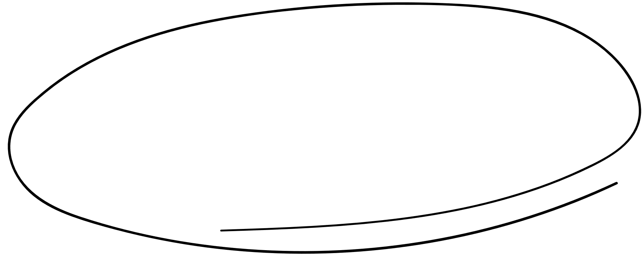

Contents
1
2
TEAM MEMBERS
PROBLEM STATEMENT
3
4
LITERATURE SURVEY
ABSTRACT
5
6
FLOW CHART
TECH STACK

Slide 3




TEAM
sHREE
GAAYATHRI V
111720102146
YUVANTHI S
111720102178
VENMATHI J
111720102171
SHALINI V
111720102144

Slide 4





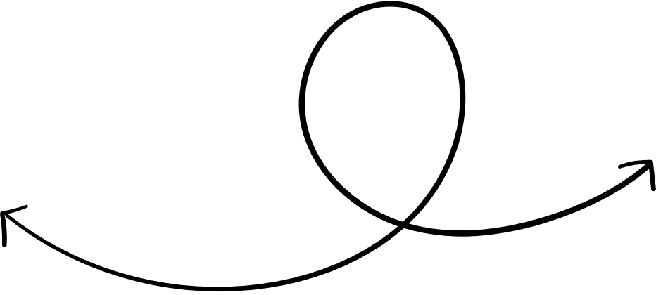

Problem Statement
Clean and safe water is an indispensable resource that directly impacts various aspects of human life, from drinking and sanitation to agriculture, industrial processes, and aquatic ecosystems. To analyze and build a model to ensure the availability of clean and safe water resources for both humans and environmental preservation.
‘’

Slide 5

Abstract
Water, constituting a significant portion of Earth's surface, is vital for life. However, rapid urbanization and industrialization have led to a troubling decline in water quality, resulting in severe health concerns. Traditional water quality assessment methods involving resource-intensive lab tests and analyses are impractical for real-time monitoring. The primary focus of the project is to leverage machine learning techniques in evaluating water quality. Water potability, a numerical metric for assessing water condition, is the central goal. A set of water quality parameters including pH, hardness, solids, chloramines, sulfate, conductivity, organic carbon, trihalomethanes, and turbidity are employed collectively as a feature vector to gauge overall water quality

Slide 6


Literature survey

Slide 7
[1] Paper Title: Machine Learning-based Water Quality Assessment: A Review
Description:
The paper "Machine Learning-based Water Quality Assessment: A Review" presents an extensive review of the application of machine learning techniques in the assessment of water quality. It explores the use of machine learning models and algorithms to predict and evaluate various water quality parameters, with a primary focus on their applicability in real-time monitoring. The review aims to provide a comprehensive overview of the field, highlighting both the merits and demerits of using machine learning for water quality assessment.

Slide 8
MERITS:
Comprehensive review of various machine learning techniques applied to water quality assessment.
Provides insights into the use of different water quality parameters and their importance.
Discusses the potential for real-time monitoring and its benefits.
Addresses the challenges and limitations of machine learning in water quality assessment.
DEMERITS:
Lacks a detailed discussion of specific case studies or applications.
May not cover the most recent advancements in the field, as the review might not be up-to-date.

Slide 9
[2] Paper Title: "Predicting Water Potability Using Machine Learning Algorithms
Description:
The paper "Predicting Water Potability Using Machine Learning Algorithms" focuses on the critical task of assessing water potability using machine learning methods. The study explores the application of various machine learning algorithms to predict whether water is safe for consumption, addressing a fundamental concern in water quality assessment. The paper presents experimental results, performance metrics, and practical implications for real-time water quality monitoring.

Slide 10
MERITS:
Focuses on the central goal of assessing water potability using machine learning.
Presents experimental results and performance metrics for various ML algorithms.
Discusses the practical implications of the model for real-time water quality monitoring.
DEMERITS:
Limited to a specific aspect (potability) of water quality assessment.
May not explore the full range of water quality parameters in depth.

Slide 11
[3] Paper Title: "Real-time Water Quality Monitoring using IoT and Machine Learning"
Description:
The paper "Real-time Water Quality Monitoring using IoT and Machine Learning" focuses on the integration of Internet of Things (IoT) technology and machine learning to enable real-time monitoring and assessment of water quality. The study explores how IoT sensors collect continuous data from various water sources, and machine learning algorithms process this data to provide real-time insights and early warnings regarding water quality issues.

Slide 12
MERITS:
Integrates IoT (Internet of Things) with machine learning for real-time monitoring.
Addresses the need for continuous data collection and analysis.
Discusses the potential for remote monitoring and control.
DEMERITS:
Focuses more on the technical aspects of IoT implementation.
Limited discussion of the specific machine learning algorithms used.

Slide 13
[4] Paper Title: "Comparison of Machine Learning Models for Water Quality Prediction
Description:
The paper "Comparison of Machine Learning Models for Water Quality Prediction" aims to assess and compare the performance of different machine learning models in predicting water quality. It presents a comprehensive analysis of various machine learning algorithms, evaluating their effectiveness in modeling and predicting water quality parameters. The paper provides insights into the advantages and disadvantages of each model to guide researchers and practitioners in selecting appropriate approaches.

Slide 14
MERITS:
Provides a comparative analysis of different machine learning models.
Evaluates the performance of these models on a variety of water quality parameters.
Discusses the advantages and disadvantages of each model.
DEMERITS:
May not delve deeply into the domain-specific challenges of water quality assessment.
Could benefit from more practical applications and case studies.

Slide 15
[5] Paper Title: Machine Learning-based Early Warning System for Water Quality
Description:
The paper "Machine Learning-based Early Warning System for Water Quality" focuses on the development of an early warning system that utilizes machine learning techniques to detect and predict water quality issues in advance. The study explores the importance of timely interventions to prevent water borne diseases and environmental damage. It presents a case study demonstrating the effectiveness of the proposed early warning system.

Slide 16
MERITS:
Emphasizes the development of an early warning system, which can be crucial for preventing waterborne diseases.
Discusses the potential for timely interventions in case of water quality degradation.
Presents a case study demonstrating the effectiveness of the proposed system.
DEMERITS:
Primarily focuses on early warning rather than comprehensive water quality assessment.
The case study might be limited in scope and applicability.

Slide 17
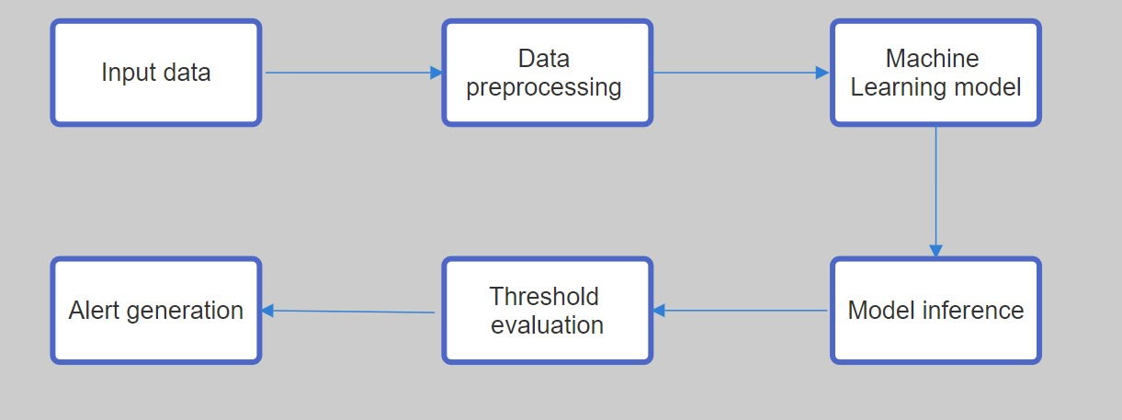
flowchart

Slide 18
Tech Stack
Programming language : Python IDE : Jupyter Notebook Front end : HTML, CSS, JS Algorithms : Decision tree, Random Forest
‘’

Slide 19
Thanks!

